Slide 1
SYSTEMS
ANALYSIS AND DESIGN
Nguyen Thanh Binh, Nguyen Quang Vu, Le Viet Truong, Nguyen Thi Hanh, Vo Van Luong, Le Thi Bich Tra
Faculty of Computer Science

Slide 2
Architectural & Deployment modelling
Package diagrams
Component diagrams
Deployment diagrams

Slide 3
Views
Static view
Class diagrams
Object diagrams
Architectural view
Package diagrams
Component diagrams
Users view
Use-case diagrams
Dynamic view
Interaction diagrams
State diagrams
Activity diagrams
Deployment view
Deployment diagrams

Slide 4

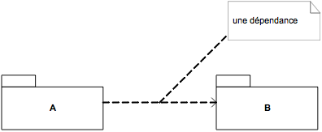
Package diagrams
A package allows to group related elements
  Several related classes are grouped together into a package
  Several related packages are grouped into another package
Notation
Dependency
  A package may depend on another package
    For example, a package refers to an element of another package
  Notation
a package
a dependency

Slide 5
Package diagrams
Example
Subsystem 1
package
Class
Dependency
Subsystem 2

Slide 6
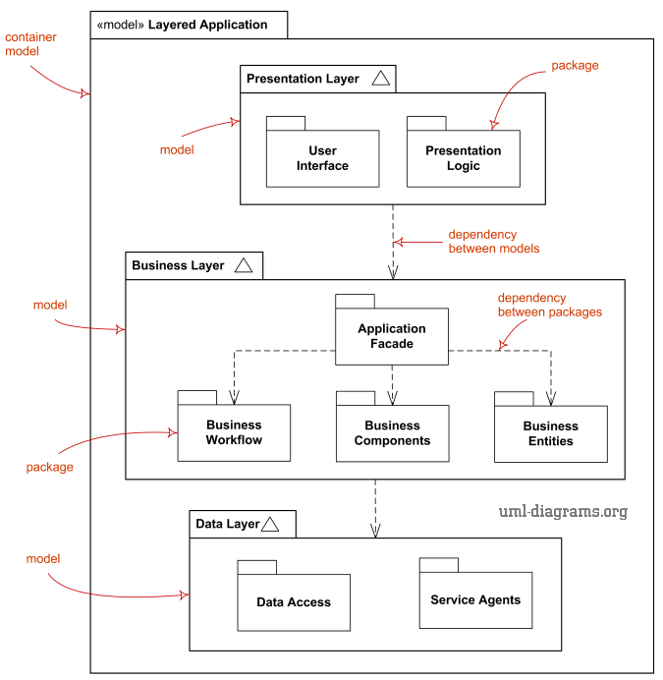
Package diagram
Why packages?
  Easy to manage, understand and manipulate
  Reduce complexity
  Iterative development: different developers, teams work simultaneously on different packages
Example

Slide 7
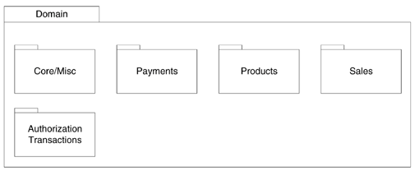
Package diagrams
Organizing principles of packages
  Functional cohesion
    Classes/interfaces that are grouped are strongly associated in terms of purpose, service, collaboration, function
      Example: all elements of the “payment” package are related to the payment of the products
Payments
CashPayment
CreditPayment
DebitPayment
“Domain” package
“Payments” package

Slide 8
Package diagrams
Organizing principles of packages
  Functional cohesion
    The cohesion of a package is quantified by
      A small value of C can say that
        The package contains too many non-related items, is not well organised
        The package contains no-related items with the intent of the designer
          for example a “tools” packages
        The package contains a subset of highly cohesive elements, but the whole is not cohesive
Number Of Internal Relationships
C =
Number Of Elements

Slide 9


Package diagrams
Organizing principles of packages (continued)
  Package of interface
    Related interfaces are placed in a package
    The implementation classes are separated
DAO
CashPayment
CreditPayment
DebitPayment
SQLiteDAO
OracleDAO
CashPaymentSQLiteImpl
CreditPaymentSQLiteImpl
CashPaymentOracleImpl
CreditPaymentOracleImpl
DebitPaymentSQLiteImpl
DebitPaymentOracleImpl

Slide 10
Package diagrams
Organizing principles of packages (continued)
  Package of unstable elements
    Stable elements are grouped in a package
    Unstable elements are grouped together in a package
      These are items that are often modified and redistributed
      To reduce the impact on the stable elements
      Example: a package includes twenty classes of which ten are often modified and redistributed. It is best to separate them into two packages: one includes ten stable classes, the other is unstable.

Slide 11
Package diagrams
Organizing principles of packages (continued)
  The more dependent the more stable
    The more dependent a package has, the more stable it should be
      Since changes on these packages has big impact on other packages
      For example, a “tools” package needs to be stable.
    Some ways to improve the stability of a package
      It contains only interfaces or abstract classes
      It doesn’t depend on other packages, or depends only on very stable packages
      It contains stable code (well implemented)
UI
use
use
use
Tools
Business
use
use
DAO

Slide 12
Package diagrams
Organizing principles of packages (continued)
  Package of independent elements
    The elements that are used independently or in different contexts are separated into different packages
    Example: SQLLite & Oracle for development/testing & production environments respectively
DAO
CashPayment
CreditPayment
DebitPayment
SQLiteDAO
OracleDAO
CashPaymentSQLiteImpl
CreditPaymentSQLiteImpl
CashPaymentOracleImpl
CreditPaymentOracleImpl
DebitPaymentSQLiteImpl
DebitPaymentOracleImpl

Slide 13

Component diagrams
A component diagram models the architectural view of the system, the physical implementation of the system
  Classes describe the logical organization, while Components describe the physical implementations
Component diagrams define physical software modules and their relationships to one another
Components may represent anything from a single class to applications, subsystems, and systems
Artifacts that implement components
The artifacts may be any type of code that can reside in any type of memory-source code, binary files, scripts, executable files, databases, or applications
Dependencies represent the types of relationships that exist between components on a Component diagram
Notation

Slide 14
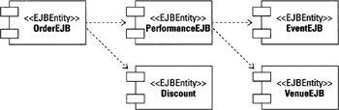
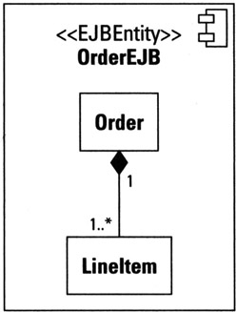
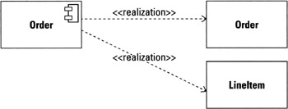
Component diagrams
Modeling dependencies
A component is an abstraction, a representation of a requirement for the physical software.
Realization refers to any implementation of a requirement.
Component can contain the realizations (implementations)

Slide 15


Component diagrams
A fundamental feature of components is the ability to define interfaces
Interfaces come in two types: required and provided
  Provided interface: defines how another component must ask for access to a provided service
  Required interface: defines an interface exactly what it needs
Example: Order component provides the services "add line items to the order", "cancel the order", and "pay for the order"; and requires discount (from other component)
Connecting required and provided interfaces to form a partnership between components

Slide 16
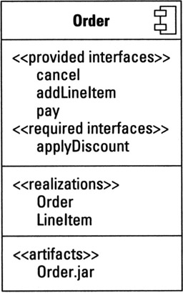
Component diagrams
UML 2.0 provides a way to represent all of the information defined so far for a component, including interfaces, realizations, and artifacts
  white box view

Slide 17
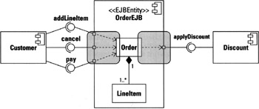
Components diagrams
Ports map the interfaces of the component to the realizations that support them
A port appears as a small square in the edge of the component

Slide 18
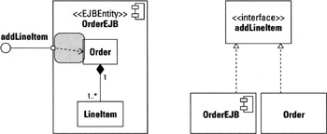
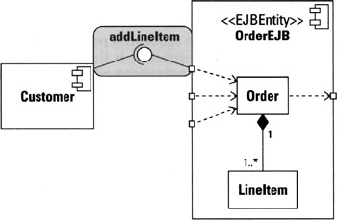
Component diagrams
A connector is a link that enables communication between two or more components
  Two types of connection: delegation connector & assembly connector
A delegation connector maps a request from one port to either another port or to a realization that provides the implementation for the request
An assembly connector is used to map a required interface to a provided interface

Slide 19
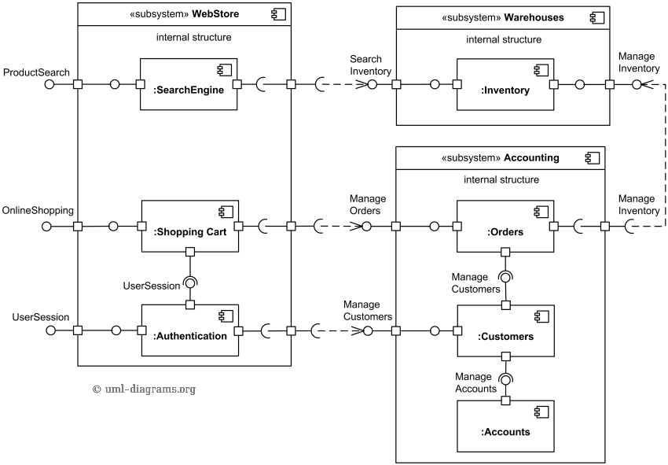
Component diagrams
Example: Online shopping example with three related subsystems - Webstore, Warehouses and Accounting

Slide 20
Deployment diagrams
Deployment diagram shows the architectural of a system as deployment (distribution) of software artifacts to deployment targets
  Artifacts represent concrete elements in physical world such as executable files, libraries, archives, database schemas, configuration files, …
  Deployment target is usually represented by a node which is either hardware device or software execution environment. Nodes could be connected
Deployments diagrams could describe architecture at specification level (also call type level) or at instance level (similar to class diagrams and object diagrams).

Slide 21
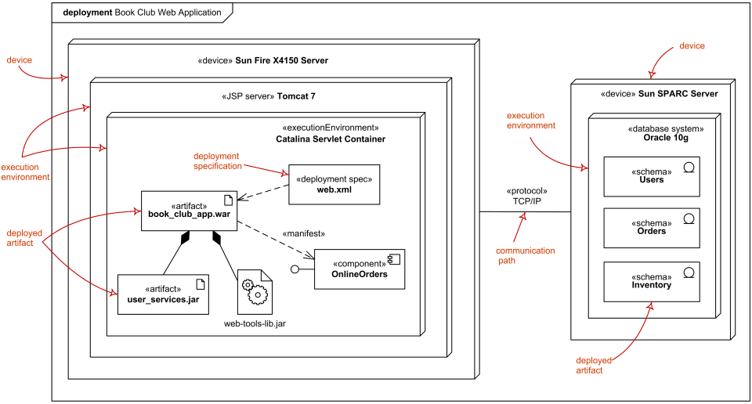
Deployment diagrams
Specification level (also call type level) deployment diagram shows some overview of deployment of artefacts to deployment targets, without referencing specific instances of artefacts or nodes.
Specification level deployment diagram -
web application deployed to Tomcat JSP server and database schemas - to database system

Slide 22
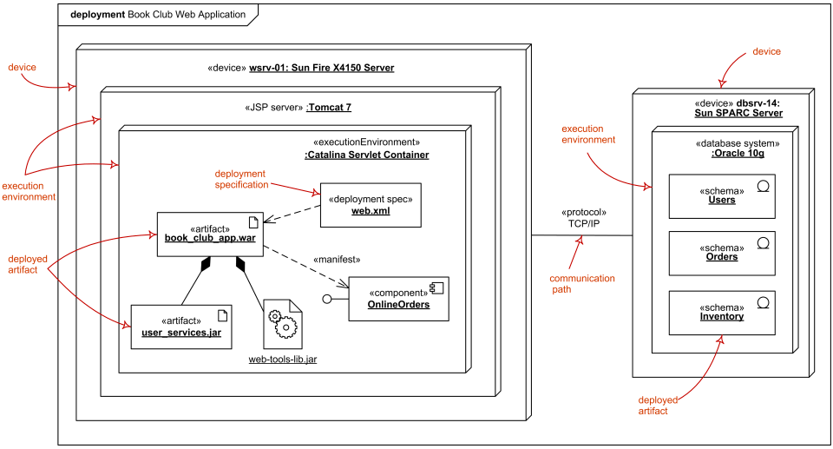
Deployment diagrams
Instance level deployment diagram shows deployment of instances of artefacts to specific instances of deployment targets. It could be useful for example to show the differences in deployments to development, staging or production environments with the names/ids specific to deployment services or devices
Instance level deployment diagram - web application deployed to Tomcat JSP server and database shemas - to database system

Slide 23
Project
Divide groups of 4-5 students
Each group chooses a problem
Building
  Package diagrams
  Component diagrams
  Deployment diagrams

